Slide 1

Internship assessment (mini project) lab code : kcs 354
Name- Asish Kumar
Branch- computer science
University roll no.- 200290120046

Slide 2

QR CODE GENERATOR
USING PYTHON
This Photo by Unknown Author is licensed under CC BY-NC

Slide 3

WHY PYTHON?
The python language is one of the most accessible programming languages available because it has simplified syntax and not complicated, which gives more emphasis on natural language. Due to its ease of learning and usage, python codes can be easily written and executed much faster than other programming languages.
Python is a general purpose and high level programming language. You can use Python for developing desktop GUI applications, websites and web applications.
This Photo by Unknown Author is licensed under CC BY-NC

Slide 4

benefits of Python
Easy to Learn & Understand
Python is Versatile
Python's Popularity
Open-Source Language
Increased Productivity.
Extensive Support Libraries.

Slide 5

What is qr code?
A QR code is a machine-readable optical label that contains information about the item to which it is attached. In practice, QR codes often contain data for a locator, identifier, or tracker that points to a website or application. A QR code uses four standardized encoding modes (numeric, alphanumeric, byte/binary, and kanji) to store data efficiently.

Slide 6
Research Paper Summaries

Slide 7
A Software Player for Providing Hints in Problem p. marino, 2009
Nowadays, learning through computers is performing a standardization process, and proper tools that are compliant with such standards are needed for the successful adoption. Several experiments have shown that the provision of hints during problem solving has been a successful strategy in the learning process. Next, there is a list of the software player features that are in accordance with the hints model requirements. The combination of all the features is allowed.
The corresponding justification for each feature is provided. Problems can be presented to students as part of assessments. Each problem can have an indefinite number of hints related to it. he hints related to a problem can be available at the beginning or they can become available only as a result of an incorrect answer to the problem. The atomic elements of hints can be text or other problems. An indefinite level of hints hierarchy can be achieved. Text Feedback is allowed in whichever problem. Hint Sequencing is allowed. Hint Grouping is allowed. Students can select a maximum number of hints from a list based on meta-information. Definition of different hints depending on the student aim is allowed. Hints for assessments and sections can be provided.
An XML binding of the full hinting data model has been provided. Different authoring tools can generate XML files that are in accordance with the hinting model, while different players can load and interpret these XML files according to the semantics with independence from the authoring tool that created it. In this way, interoperability between different hinting systems and reusability of different hinting descriptions can be achieved. We have implemented the first player that is full compliant to this new hints specification, and this software module can interpret and run these XML files with the help of the XTutor system. At present, we are using the XTutor hints player in classroom in order to let students interact with created hinting material. From quantitative and qualitative data analysis from the experiences, we can infer that the tool is very useful in the learning process and positive results have been obtained.

Slide 8
Computer programming with Python for industrial and system engineers kasey j. hill 2017
Programming requires students to break a large problem into smaller pieces and then solve them piece by piece. A basic understanding of programming is a necessity in nearly every engineering field. It is even more so in the future of technological growth and development. first question that needed to be answered was which programming language should be taught. After a thorough survey of the popularity and practicality of a variety of programming languages, Python was found to be the best alternative. Python greatly reduces the complexity of problem solving by hiding the intricate “what is really happening under the hood” side of computing. Python is a high-level language that is consistently ranked among the most popular programming languages by TIOBE Index , IEEE Spectrum , and GitHut . In a recent survey by the Association for Computing Machinery. Python surpassed Java as the top introductory teaching language. Eight of the top ten universities in the United States use Python to introduce programming. The significance of an open-source alternative. Notevery one has access to a “free” Matlab license, and Matlab may not be available to students when they leave the university. Python offers them a free, always available option. The easy installation of Python distributions. Recent Python distributions such as Anaconda and Enthought Canopy provide “oneclick” installers that make the establishment of scientific and engineering computing environment much easier than installing Matlab.

Slide 9
The nice integration with lecture notes. This is a bonus point for teachers because they have been increasingly integrating code into lecture notes to enhance students learning. This integration is not easy with Matlab, but it is straight forward with Python through Jupyter Notebook. Lessons learned from the instructor’s and the students’ perspectives are presented. Endcourse surveys helped in understanding both the successes as well as areas that need improvement. This paper identifies that the learning performance is slightly different for female and male students, which may be caused by the difference in sample sizes. There are also reasonable differences according to students’ class standing and attendance. The introduction of this course into the undergraduate curriculum has helped fillan observed deficit in the ISE program. Students learned how to apply Python programming skills to solve diverse, but relevant, ISE problems. Students have been better prepared for future employment and academic opportunities through establishment of this base in computer programming. In accordance with the great interest among students in learning how Python can be used to mine Twitter and Facebook data, the plan is to integrate one mor e chapter titled “Network for Social Media Mining.” Networkx is a library that can create and manipulating networks with complex structures and dynamics. An introduction to the basic s of the agent-based model (ABM), an important system engineering technique, will be integrated into this chapter as well. ABM can be used to simul ate the actions and interactions among individuals with a view to assessing their effects on the system as a whole.

Slide 10
Grammar engineering for multiple front-ends for Python Brian A. Malloy, 2015
Grammars for programming languages can be conducted in either a theoretical context, such as the study of parsing algorithms, or a software development context, where grammars are seen as a software artefact. The second context is particularly relevant to the practice of software engineering, since many of the tools used to analyse, measure and translate software are grammar-based systems.
One problem that arises in grammar engineering is the construction of grammar ware for the various dialects or versions of a language. The rules consist of terminal symbols that represent tokens in the language and nonterminal symbols that are used to rewrite the rules used in the derivation of the program. Grammars can be expressed in many formalisms; however, in this paper, we use the term grammar to refer to either a CFG or a grammar in EBNF format. When necessary, we refer specifically to either CFG or the EBNF format. A parser is a software component that accepts a program as input and determines if that program is syntactically correct with respect to the grammar used to build the parser, which we refer to as the reference grammar.
A compiler writer, like any software developer, can profit from the use of software development tools including parser generators such as yacc, bison, antlr, or menhir.19, 20 The bison and menhir parser generators are generalised forms of yacc; however, bison cannot accept a grammar in EBNF format but rather the grammar must be transformed into a machine readable format known as bison syntax or bison grammar. In a bison grammar, a non-terminal or terminal symbol is represented as an identifier, similar to a C identifier. Terminal symbols are also known as token types and can be represented as character literals. In this paper, we refer to a grammar that has been transformed from EBNF into bison syntax as a yaccified grammar. we report on the construction of a front end for Python based on integrating our parsers with a flex-based scanner. We provide empirical evidence of the success of this strategy using a test suite of Python programs

Slide 11
a Python package for enhanced concurrent programming Todd Williamson 2012
The popularity of Python has increased considerably. Python is widely used and has been demonstrated to be effective over many problem domains including scripting, prototyping, and simulation. This paper introduces PySy 2, a Python package, as a way to achieve true concurrency in Python and to provide an interface that easily expresses high-level concurrency and distributed programming mechanisms. Python's scoping is slightly simpler than that in languages like C, C++, and Java.
One of the main differences is that code blocks introduced by conditionals and loops do not create a new scope. In Python, each file has its own global scope and only the method construct (method definition or lambda definition) adds a new scope. The development process was a balancing act. The ideologies of Python and Java are quite opposing. In the imperative programming world, Python and Java appear to be polar opposites. Java provides an environment that focuses on statically enforcing type safety and general object oriented programming structure, whereas Python is dynamically typed (yet still type safe) and puts the onus on its users to correctly manage the interaction between objects.
So, adapting a product of Java to Python was bound to have interesting issues. With that said, PySy is not a direct mapping of JR to Python. Throughout the development process, we attempted to merge the functionality of JR into Python without losing the spirit of JR and without deviating from conventional Python programming practices. The development of PySy has concentrated on providing JR-like functionality and establishing a friendly user-interface. However, there is still more work to be carried out. PySy, at the time of this writing, implements most of the major JR features, save two: quantifiers and parameterized VMs. We are currently designing the interface for both of these features and hope to implement them shortly. PySy provides a reasonable alternative to other Python concurrency programming packages. The quantitative results in Section 5 show that PySy (without QD) is 1.5–2 times slower than the Python's multiprocessing package for distributed programs that utilize an FFT algorithm and perform matrix multiplication. We believe that we can drastically improve PySy's performance by implementing a few optimizations. Python has discontinued its feature development of Python 2.x with version 2.7.2. All future development is being applied to Python 3. It only makes sense to port PySy to the future of the Python language. The Python 3 distribution provides a tool 2to3.py 1 that automatically converts Python 2.x programs to Python 3. However, Python 3 is not compatible with Pyro3. So, to convert PySy to Python 3, we would have to replace Pyro3 with another distributed programming package, such as Pyro4.

Slide 12
Python framework for object oriented modeling of bioprocesses Johannes Hemmerich, 2009
Biotechnological production processes leverage the microorganisms’ synthesis capacity to produce com-plex molecules that are hardly accessible by traditional chemical synthesis. Importantly, modern genetic engineering methods allow for targeted modification of single enzymes and whole metabolic pathways for biochemically accessing value-added compounds beyond those naturally available. the pyFOOMB package that enables the implementation of bioprocess models as systems of ordinary differential equations (ODEs) via the multi-purpose programing language Python. Based on the object-oriented paradigm, pyFOOMB provides a variety of classes for the rapid and flexible formulation, validation and application of ODE-based bioprocess models.
In a first step, the targeted model and its parametrization is implemented by creating a userspecific subclass of the provided class Bioprocess Model . This basic class provides all necessary methods and properties to run simulations for the implemented model. Essentially, the abstract method rhs must be formulated by the user. Noteworthy, the pyFOOMB package does not allow for consistency checking of units for the state variables or model parameters. This responsibility is left to the user while formulating a model, i.e., before coding the model as Bioprocess Model subclass. To monitor and control the dynamics of specific model variables so-called state_events() and change_states() methods can be defined. This is for example required for the modeling of multi-phased processes such as fed-batch with event-based changes in feeding regimes.
The pyFOOMB package provides straight-forward access to the formulation of bioprocess models in a programmatic and object-oriented manner. Based on the powerful, yet beginner friendly Python programing language, the package addresses a wide range of users to implement models with growing complexity. For example, by employing event methods, pyFOOMB supports the modeling of discrete behaviors in process quantities, which is an important feature for the simulation and optimization of fed-batch processes. The concept of model replicates and definition of local and global parameters mirrors the iterative nature of data generation from cycles of experiment design, execution and evaluation

Slide 13
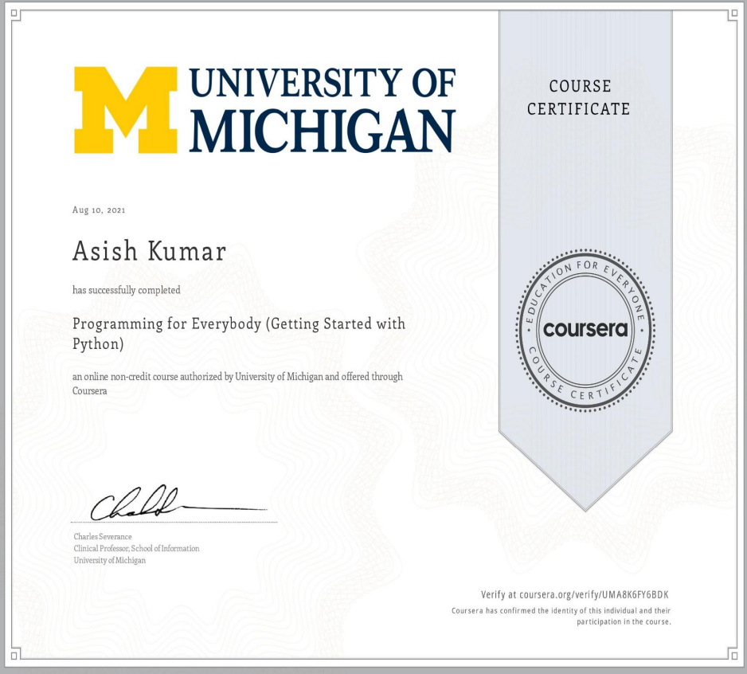
certificate

Slide 14
Conclusion of Internship
I learnt a lot of new skills and these skills will surely help in further studies and placements. I will surely keep on learning these skills and keep on enhancing them. The faculties were helpful and skilled properly and made us learn these skills so easily. I learnt python programming in the due course of internship and will try to enhance these skills further in future

Slide 15

Thank you

